Slide 1
Chapter 5
How Do Risk and Term Structure Affect
Interest Rates?

Slide 2
Financial System Overview (2)
Financial Markets
Financial Institutions
Bond Market (3,5,12)
Stock Market (13,6)
Money Market (11)
Mortgage Market (14)
Why Exists (7)
Banking Industry (19)
Mutual Fund Industry(20)
Hedging with Financial Derivatives (24)

Slide 3
Chapter 5: How do Risk and Term Structure Affect Interest Rates
Risk structure of Interest Rates
Term structure of Interest Rates
Two definitions:
Risk structure of interest rates: bonds with the same term to maturity have different interest rates
Term structure of interest rates: same rating bonds with different terms to maturity have different interest rates

Slide 4
Chapter Preview
In the last chapter, we examined interest rates, but made a big assumption—there is only one economy-wide interest rate. In this chapter, we will examine the different rates that we observe for financial products.
We will examine how the individual risk of a bond affects its required rate. We also explore how the general level of interest rates varies with the maturity of the debt instruments.

Slide 5
Chapter Outline
Risk Structure of Interest Rates
Term Structure of Interest Rates

Slide 6
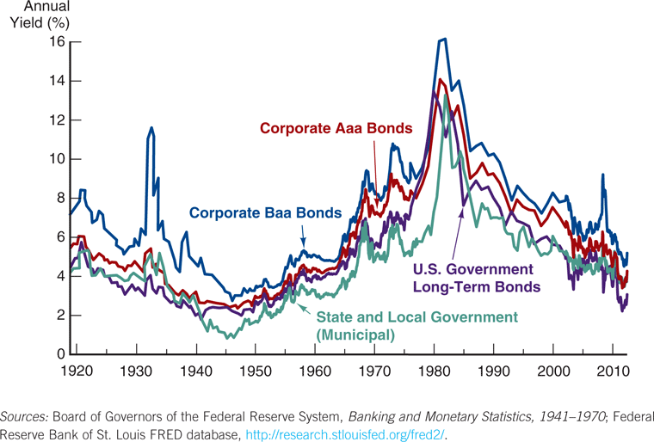
Risk Structure of Interest Rates
Rates on different bond categories change from one year to the next.
Spreads on different bond categories change from one year to the next.

Slide 7
Factors Affecting Risk Structure of Interest Rates
Default Risk
Liquidity
Income Tax Considerations

Slide 8
Default Risk Factor
One attribute of a bond that influences its interest rate is its risk of default, which occurs when the issuer of the bond is unable or unwilling to make interest payments when promised.
U.S. Treasury bonds have usually been considered to have no default risk because the federal government can always increase taxes to pay off its obligations (or just print money). Bonds like these with no default risk are called default-free bonds.

Slide 9
Default Risk Factor
But are these bonds truly default-free bonds?
During the budget negotiations in Congress in 1995 - 1996, and then again in 2011 - 2013, the Republicans threatened to let Treasury bonds default, and this had an impact on the bond market.
If these bonds were truly “default-free,” we should not have seen any reaction.
S&P downgrades US credit rating on 6 Aug, 2011
http://www.cbsnews.com/news/sp-downgrades-us-debt/
https://en.wikipedia.org/wiki/List_of_sovereign_debt_crises

Slide 10
Default Risk Factor (cont.)
The spread between the interest rates on bonds with default risk and default-free bonds, called the risk premium, indicates how much additional interest people must earn in order to be willing to hold that risky bond.
A bond with default risk will always have a positive risk premium, and an increase in its default risk will raise the risk premium.

Slide 11
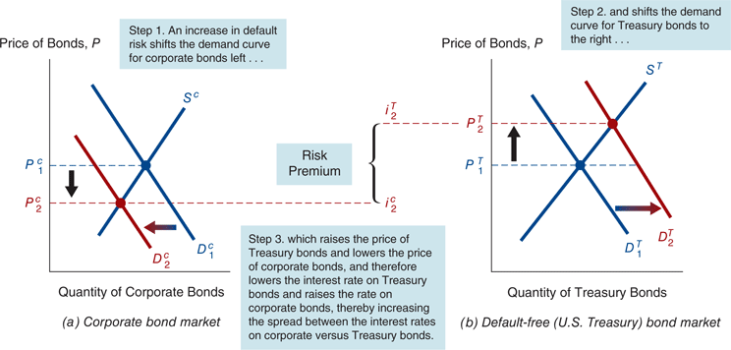
Increase in Default Risk on Corporate Bonds
Figure 5.2 Response to an Increase in Default Risk on Corporate Bonds

Slide 12
Analysis of Figure 5.2: Increase in Default on Corporate Bonds
Corporate Bond Market
1. R^{e} on corporate bonds ↓, D^{c} ↓, D^{c} shifts left
2. Risk of corporate bonds ↑, D^{c} ↓, D^{c} shifts left
3. P^{c} ↓, i^{c} ↑
Treasury Bond Market
1. Relative R^{e} on Treasury bonds ↑, D^{T} ↑, D^{T} shifts right
2. Relative risk of Treasury bonds ↓, D^{T} ↑, D^{T} shifts right
3. P^{T} ↑, i^{T} ↓
Outcome
A bond with default risk will always have a positive risk premium
An increase in default risk will raise the risk premium

Slide 13
Default Risk Factor (cont.)
Default risk is an important component of the size of the risk premium.
Because of this, bond investors would like to know as much as possible about the default probability of a bond.
One way to do this is to use the measures provided by credit-rating agencies: Moody’s and S&P are examples.

Slide 14
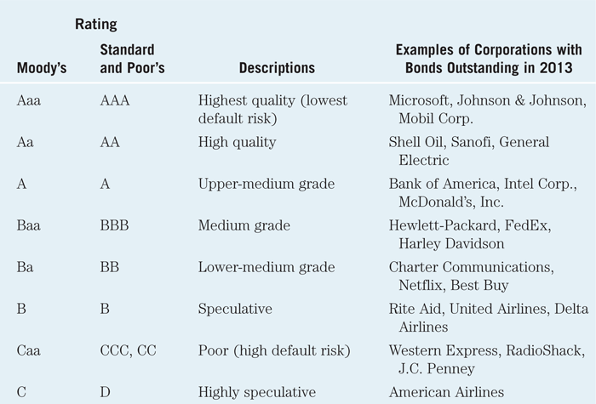
Table 5.1 Bond Ratings by Moody’s and Standard and Poor’s

Slide 15
One-Year Transition Matrix (S&P Report)

Slide 16
Cumulative Average Default Rates (%) (S&P Report)

Slide 17
Cumulative Ave Default Rates (%) (Moody’s Report)

Slide 18
Case: The Global Financial Crisis and the Baa-Treasury Spread
Starting in 2007, the subprime mortgage market collapsed, leading to large losses for financial institutions.
Because of the questions raised about the quality of Baa bonds, the demand for lower-credit bonds fell, and a “flight- to-quality” followed (demand for T-securities increased.
Result: Baa-Treasury spread increased from 185 bps to 545 bps.

Slide 19
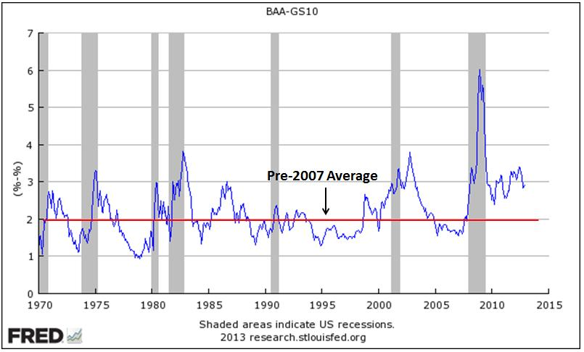
http://macromarketmusings.blogspot.hk/2013/01/why-we-need-more-private-safe-assets.html

Slide 20
Liquidity Factor
A liquid asset is one that can be quickly and cheaply converted into cash if the need arises. The more liquid an asset is, the more desirable it is (higher demand), holding everything else constant.
The differences between interest rates on corporate bonds and Treasury bonds (that is, the risk premiums) reflect not only the corporate bond’s default risk but its liquidity too.
This is why a risk premium is sometimes called a risk and liquidity premium.

Slide 21
Corporate Bond Becomes Less Liquid
Corporate Bond Market
1. Liquidity of corporate bonds ↓, D^{c} ↓, D^{c} shifts left
2. P^{c} ↓, i^{c} ↑
Treasury Bond Market
1. Relatively more liquid Treasury bonds, D^{T} ↑, D^{T} shifts right
2. P^{T} ↑, i^{T} ↓
Outcome
Risk premium, i^{c} - i^{T}, rises
Risk premium reflects not only corporate bonds’ default risk but also lower liquidity

Slide 22
Income Taxes Factor
An odd feature of Figure 5.1 is that municipal bonds tend to have a lower rate the Treasuries. Why?
Munis certainly can default. Orange County (California) is a recent example from the early 1990s.
Munis are not as liquid a Treasuries.

Slide 23
Income Taxes Factor
However, interest payments on municipal bonds are exempt from federal income taxes, a factor that has the same effect on the demand for municipal bonds as an increase in their expected return.
Treasury bonds are exempt from state and local income taxes, while interest payments from corporate bonds are fully taxable.

Slide 24
Income Taxes Factor
Example:
Assume the income tax rate is 35%.
If you own a $1,000-face-value U.S. Treasury bond that sells for $1,000 and has a coupon payment of $100, you get to keep only $65 of the payment after taxes.
If you own $1,000-face-value municipal bond that sells for $1,000 and pays only $80 in coupon payment.
The interest rate for the U.S. Treasury is 10%, for the municipal bond is 8%, however, which one is better for you?

Slide 25
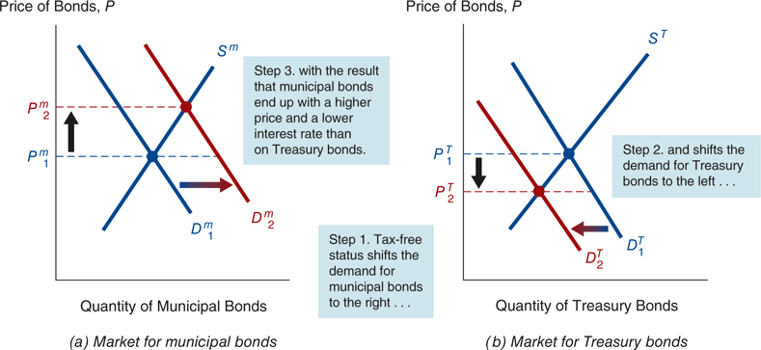
Tax Advantages of Municipal Bonds
Figure 5.3 Interest Rates on Municipal and Treasury Bonds

Slide 26
Analysis of Figure 5.3: Tax Advantages of Municipal Bonds
Municipal Bond Market
1. Tax exemption raises relative R^{e} on municipal bonds, D^{m} ↑, D^{m} shifts right
2. P^{m} ↑
Treasury Bond Market
1. Relative R^{e} on Treasury bonds ↓, D^{T} ↓, D^{T} shifts left
2. P^{T} ↓
Outcome
i^{m} < i^{T}

Slide 27
Case: Bush Tax Cut and Obama Repeal on Bond Interest Rates
The 2001 tax cut called for a reduction in the top tax bracket, from 39% to 35% over a 10-year period.
This reduces the advantage of municipal debt over T-securities since the interest on T-securities is now taxed at a lower rate.
The Bush tax cuts were repealed under President Obama. Our analysis is reversed. The advantage of municipal debt increased relative to T-securities, since the interest on T-securities is taxed at a higher rate.

Slide 28
Summary of the risk structure of interest rate
The risk structure of interest rates (the relationship among interest rates on bonds with the same maturity) can be explained by three factors:
Default risk: default risk increases➔ the risk premium rises.
Liquidity: higher liquidity ➔ lower interest rate
Income tax treatment of the bond’s interest payments

Slide 29
Chapter Outline
Risk Structure of Interest Rates
Term Structure of Interest Rates

Slide 30
Term Structure of Interest Rate
Several definition:
Term structure: bonds with identical risk, liquidity, and tax characteristics may have different interest rates because the time remaining to maturity is different.
Yield curve: a plot of the yields on bonds with differing terms to maturity but the same risk, liquidity, and tax considerations.
Upward yield curve: the long-term interest rates are above the short-term interest rates
Flat yield curve: short- and long-term interest rates are the same
Inverted yield curve: long-term interest rates are below short-term interest rates.
Yield curve is a measure of the market’s expectations of future interest rates given current market conditions.

Slide 31
Three Typical Shapes of Yield Curve
1. Normal yield curve
You can see this upward sloping yield curve during normal market conditions, when investors expect higher yield for fixed income instruments with long-term maturities as a compensation for bearing additional risk.
Yield
Maturity

Slide 32
Three Typical Shapes of Yield Curve
2. Inverted yield curve
Often interpreted as an indication that the economy will soon experience a slowdown. Before a slowdown, it is better to lock money into long-term investments at present prevailing yields.
Yield
Maturity

Slide 33
Three Typical Shapes of Yield Curve
3. Flat curve
Signals that the market is making a transition; for example, in a transition period from normal to recession, short-term interest rate will rise and long-term interest rates will fall.
Yield
Flat
Maturity

Slide 34
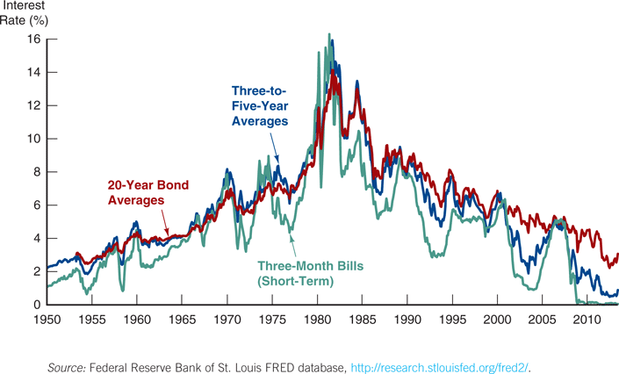
Interest Rates on Different Maturity Bonds Move Together
Figure 5.4 Movements over Time of Interest Rates on U.S. Government Bonds with Different Maturities

Slide 35
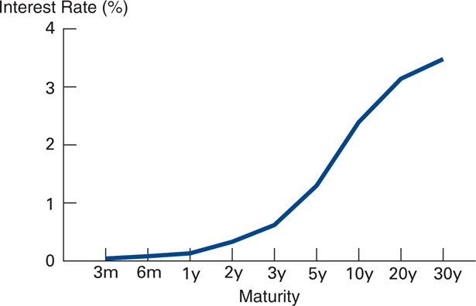
Term Structure Facts to Be Explained
Besides explaining the shape of the yield curve, a good theory must explain why:
Interest rates for different maturities move together.
Yield curves tend to have steep upward slope when short rates are low and a downward slope when short rates are high.
Yield curve is typically upward sloping.

Slide 36
Three Theories of Term Structure
Expectations Theory
Pure Expectations Theory explains 1 and 2, but not 3
Market Segmentation Theory
Market Segmentation Theory explains 3, but not 1 and 2
Liquidity Premium Theory
Solution: Combine features of both Pure Expectations Theory and Market Segmentation Theory to get Liquidity Premium Theory and explain all facts

Slide 37
 | Fact 1 | Fact 2 | Fact 3
Expectations Theory |  |  | X
Market Segmentation Theory | X | X | 
Liquidity Premium Theory |  |  | 

Slide 38
Expectations Theory
Commonsense of expectations theory:
the interest rate on a long-term bond will equal an average of short-term interest rates that people expect to occur over the life of the long-term bond.
Key Assumption:
Buyers of bonds do not prefer bonds of one maturity over another, so they will not hold any quantity of a bond if its expected return is less than that of another bond with a different maturity. Bonds that have this characteristic are said to be perfect substitutes.
In practice is that the expected return on these bonds must be equal.

Slide 39
Expectations Theory
To illustrate what this means, consider two alternative investment strategies for a two-year time horizon.
Buy $1 of one-year bond, and when it matures, buy another one-year bond with your money.
Buy $1 of two-year bond and hold it.
The important point of this theory is that if the Expectations Theory is correct, your expected wealth is the same (at the start) for both strategies.

Slide 40
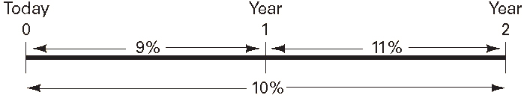
Expectations Theory
The current interest rate on a 1-year bond is 9%, and you expect the interest rate on the 1-year bond next year to be 11%. What is the expected return over the two years? What interest rate must a 2-year bond have to equal the two 1-year bonds?

Slide 41
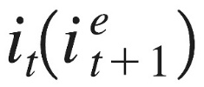
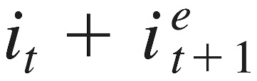
Expectations Theory
i_{t}=today’s (time t) interest rate on a one-period bond
i^{e}_{t+1}=interest rate on a one-period bond expected for next period (time t+1)
i_{2t}=today’s (time t) interest rate on the two-period bond
Expected return from strategy 1
Since is also extremely small, expected return is approximately

Slide 42
Expectations Theory
Expected return from strategy 2
Since (i_{2t})² is extremely small, expected return is approximately 2(i_{2t})

Slide 43
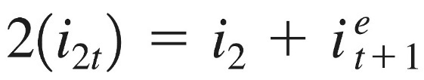
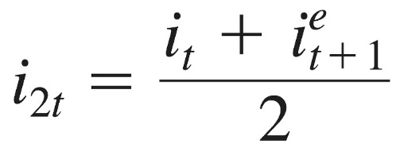
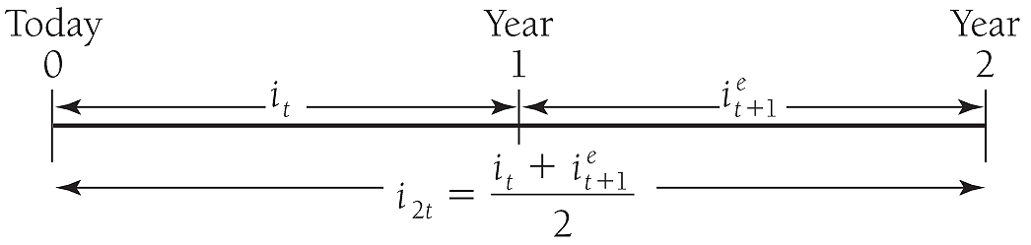
Expectations Theory
From implication above expected returns of two strategies are equal
Therefore
Solving for i_{2t}

Slide 44
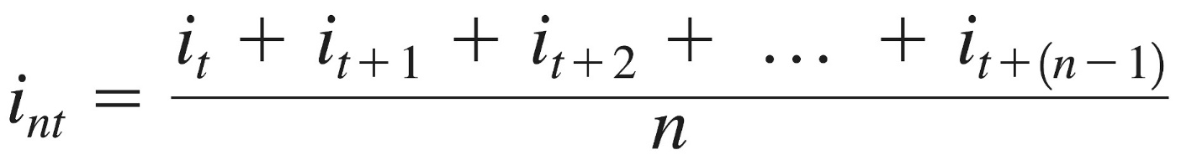
More generally for n-period bond…
Don’t let this seem complicated. Equation simply states that the interest rate on a long-term bond equals the average of short rates expected to occur over life of the long-term bond.

Slide 45
More generally for n-period bond…
Numerical example
One-year interest rate over the next five years are expected to be 5%, 6%, 7%, 8%, and 9%
Interest rate on two-year bond today: (5% + 6%)/2 = 5.5%
Interest rate for five-year bond today: (5% + 6% + 7% + 8% + 9%)/5 = 7%
Interest rate for one- to five-year bonds today: 5%, 5.5%, 6%, 6.5% and 7%

Slide 46
Expectations Theory and Term Structure Facts
Explains why yield curve has different slopes
When short rates are expected to rise in future, average of future short rates is above today's short rate; therefore yield curve is upward sloping.
When short rates expected to stay same in future, average of future short rates same as today’s, and yield curve is flat.
Only when short rates expected to fall will yield curve be downward sloping.

Slide 47
Expectations Hypothesis and Term Structure Facts
Expectations Hypothesis can explain:
Short and long rates move together
If i_{t} ↑, i^{e}_{t+1}, i^{e}_{t+2} etc. ↑ ⇒ average of future rates ↑ ⇒ i_{nt} ↑
i_{t} ↑ ⇒ i_{nt} ↑, i.e., short and long rates move together
Yield curves tend to have steep upward slope when short rates are low and downward slope when short rates are high
When short rates are low, they are expected to rise to normal level, so long rate (average of future short rates) will be well above today’s short rate: yield curve will have steep upward slope
When short rates are high, they will be expected to fall in future, and long rate will be below current short rate: yield curve will have downward slope

Slide 48
Expectations Theory and Term Structure Facts
Doesn’t explain fact 3—that yield curve usually has upward slope
Short rates are as likely to fall in future as rise, so average of expected future short rates will not usually be higher than current short rate: therefore, yield curve will not usually slope upward.

Slide 49
Segmented Markets Theory
Segmented markets theory:
markets for different-maturity bonds are completely separate and segmented. The interest rates for each bond with a different maturity is then determined by the supply and demand for that bond with no effects from expected returns on other bonds with other maturities.
Key Assumption
Bonds of different maturities are not substitutes at all. Investors have strong preferences for bonds of one maturity but not for another.
Short-term maturities
Supply: banks
Demand: business with seasonal loan requirements
Long-term maturities
Supply and demand: life insurance, real estate

Slide 50
Segmented Markets Theory
Segmented markets theory can explain:
yield curve is usually upward sloping
People typically prefer short holding periods and thus have higher demand for short-term bonds, which have higher price and lower interest rates than long bonds
Segmented markets theory cannot explain:
short and long rates move together
yield curves tend to have steep upward slope when short rates are low and downward slope when short rates are high
Because segmented markets theory assumes long and short rates determined independently

Slide 51
Liquidity Premium Theories
Liquidity premium theory
The interest rate on a long-term bond will equal an average of short-term interest rates expected to occur over the life of the long-term bond plus a liquidity premium (term premium) that responds to supply and demand conditions for that bond.
Key Assumption
Expected return on one bond does influence the expected return on a bond of a different maturity.
Investors prefer one bond maturity over another. Investors tend to prefer shorter-term bonds because these bonds bear less interest-rate risk. So, investors must be offered a positive liquidity premium for holding longer-term bonds.
Bonds of different maturities are substitutes, but are not perfect substitutes.

Slide 52
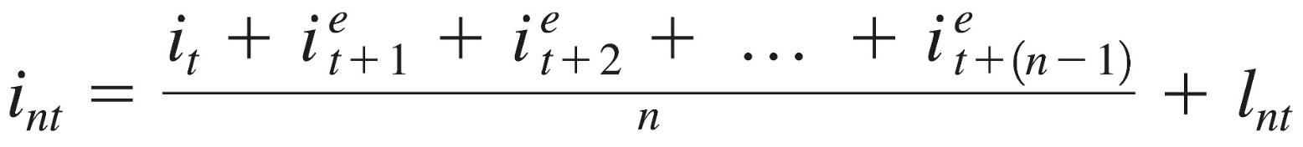
Liquidity Premium Theory
Results in following modification of Expectations Theory:
where l_{nt} is the liquidity premium for the n-period bond at time t, which is always positive and rises with the term to maturity of the bond, n..
We can also see this graphically…

Slide 53
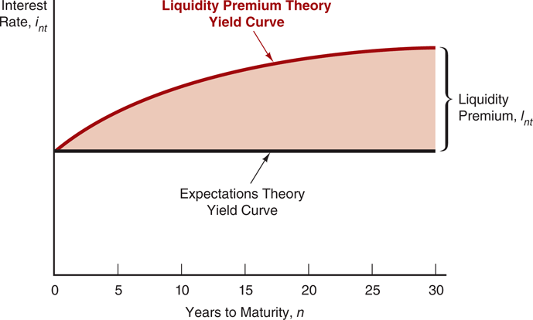
Liquidity Premium Theory
Figure 5.5 The Relationship Between the Liquidity Premium and Expectations Theories

Slide 54
Numerical Example
One-year interest rate over the next five years: 5%, 6%, 7%, 8%, and 9%
Investors’ preferences for holding short-term bonds so liquidity premium for one- to five-year bonds: 0%, 0.25%, 0.5%, 0.75%, and 1.0%

Slide 55
Numerical Example
Interest rate on the two-year bond: 0.25% + (5% + 6%)/2 = 5.75%
Interest rate on the five-year bond: 1.0% + (5% + 6% + 7% + 8% + 9%)/5 = 8%
Interest rates on one to five-year bonds: 5%, 5.75%, 6.5%, 7.25%, and 8%
Comparing with those for the pure expectations theory, liquidity premium theory produces yield curves more steeply upward sloped.

Slide 56
Liquidity Premium Theory: Term Structure Facts
Explains All 3 Facts
Explains fact 3—that usual upward sloped yield curve by liquidity premium for long-term bonds
Explains fact 1 and fact 2 using same explanations as pure expectations theory because it has average of future short rates as determinant of long rate

Slide 57
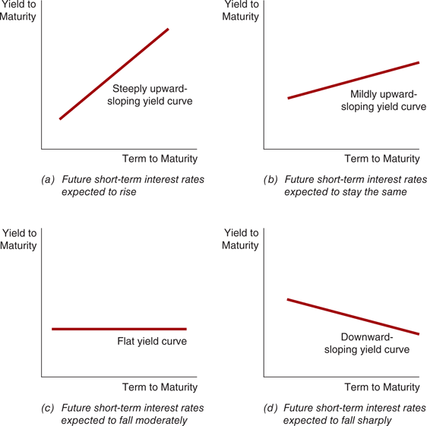
Figure 5.6 Yield Curves and the Market’s Expectations of Future Short-Term Interest Rates According to the Liquidity Premium Theory

Slide 58
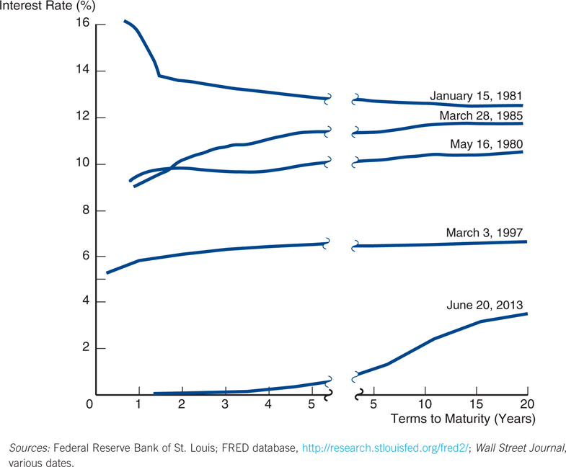
Figure 5.7 Yield Curves for U.S. Government Bonds 1980-2013

Slide 59
Case: Interpreting Yield Curves
The steep downward curve in 1981 suggested that short-term rates were expected to decline in the near future. This played-out, with rates dropping by 300 bps in 3 months.
The upward curve in 1985 and 2013 suggested a rate increase in the near future.
The moderately upward slopes in 1980 and 1997 suggest that short term rates were not expected to rise or fall in the near term.
The steep upward slope in 2013 suggests short term rates in the future will rise.

Slide 60
Summary of this Chapter
Risk structure of Interest Rates (the relationship among interest rates on bonds with the same maturity) can be explained by three factors:
Default risk: default risk increases ==> the risk premium rises.
Liquidity: higher liquidity ==> lower interest rate
Income tax treatment of the bond’s interest payments
Term structure of Interest Rates
Expectations Theory
Segmented Markets Theory
Liquidity Premium (Preferred Habitat) Theory

